Slide 1
JARVIS Voice Assistant
Kaniz Fatima-18201030
Mehedi Hasan-18201042

Slide 2
CONTENTS
ERD Diagram.
Project VCS Link.

Slide 3
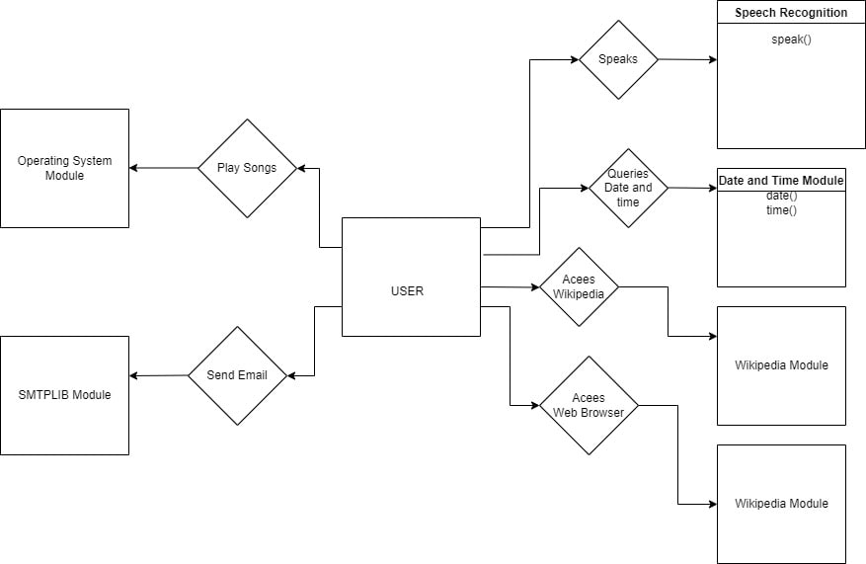
ERD Diagram

Slide 4
Project VCS Link
https://github.com/mhf221b/JARVIS_AI_Assistant

Slide 5
THE END!
Thank You!

